Slide 1


MedScan: Multimodal Medical Report Analyzer
An assistive AI system for medical report processing
Presented by: Kapil & Kamalesh Mukherjee

Slide 2
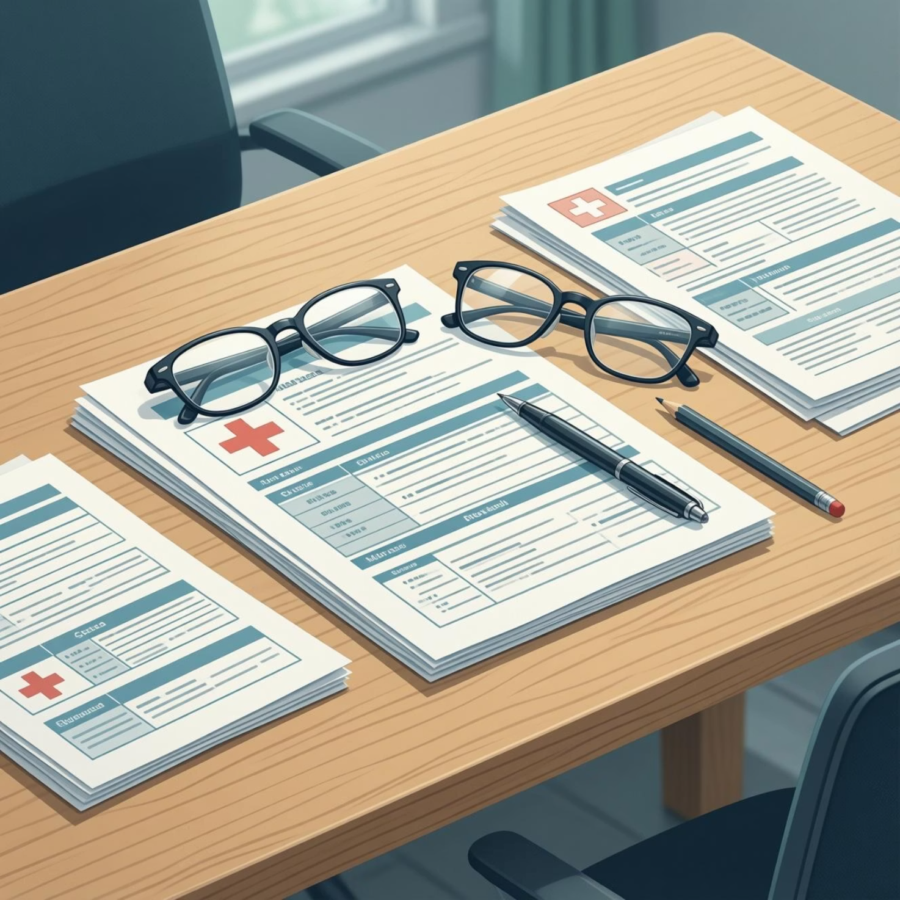

Motivation & Context
Medical reports contain valuable information in multiple formats—text, tables, and images—but lack standardization across healthcare providers.
Manual processing is time-consuming and prone to inconsistencies. Patients and healthcare professionals need better tools to organize and extract insights from diverse medical documents.
This project explores how multimodal AI techniques can assist in structuring unstructured medical data.

Slide 3
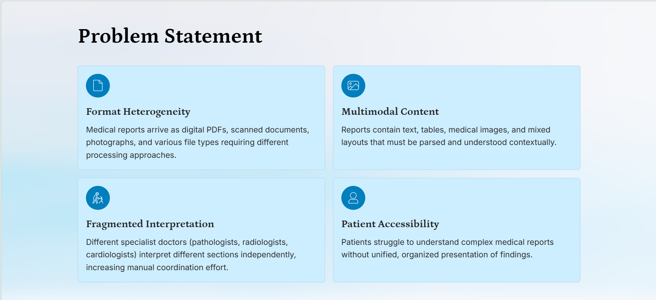

Slide 4
The Challenge
Format Variability
Mixed Content Types
Information Extraction
Reports come as scanned PDFs, images, or digital text with no consistent structure
Text narratives, laboratory tables, and diagnostic images coexist in single documents
Relevant data is buried within unstructured formats requiring manual effort to parse
Existing tools handle only one content type at a time, creating gaps in comprehensive report analysis.

Slide 5
Project Objectives
01
02
Extract text from multiple document formats
Identify and extract tabular data
Handle both digital PDFs and scanned images with OCR fallback
Process lab reports and structured data tables accurately
03
04
Structure unstructured reports
Classify embedded medical images
Organize narrative text into meaningful clinical sections
Detect and categorize diagnostic image types within reports

Slide 6
What This Project Includes—and Excludes
Within Scope
This system does NOT provide:
Text extraction from PDF and image formats
Disease diagnosis or clinical interpretation
Table detection and data extraction
Treatment recommendations or therapeutic guidance
Rule-based report structuring
Clinical decision support or care protocols
Image extraction and modality classification
Replacement of specialist physicians or radiologists
Multi-format document processing pipeline
Validation for clinical or legal purposes

Slide 7

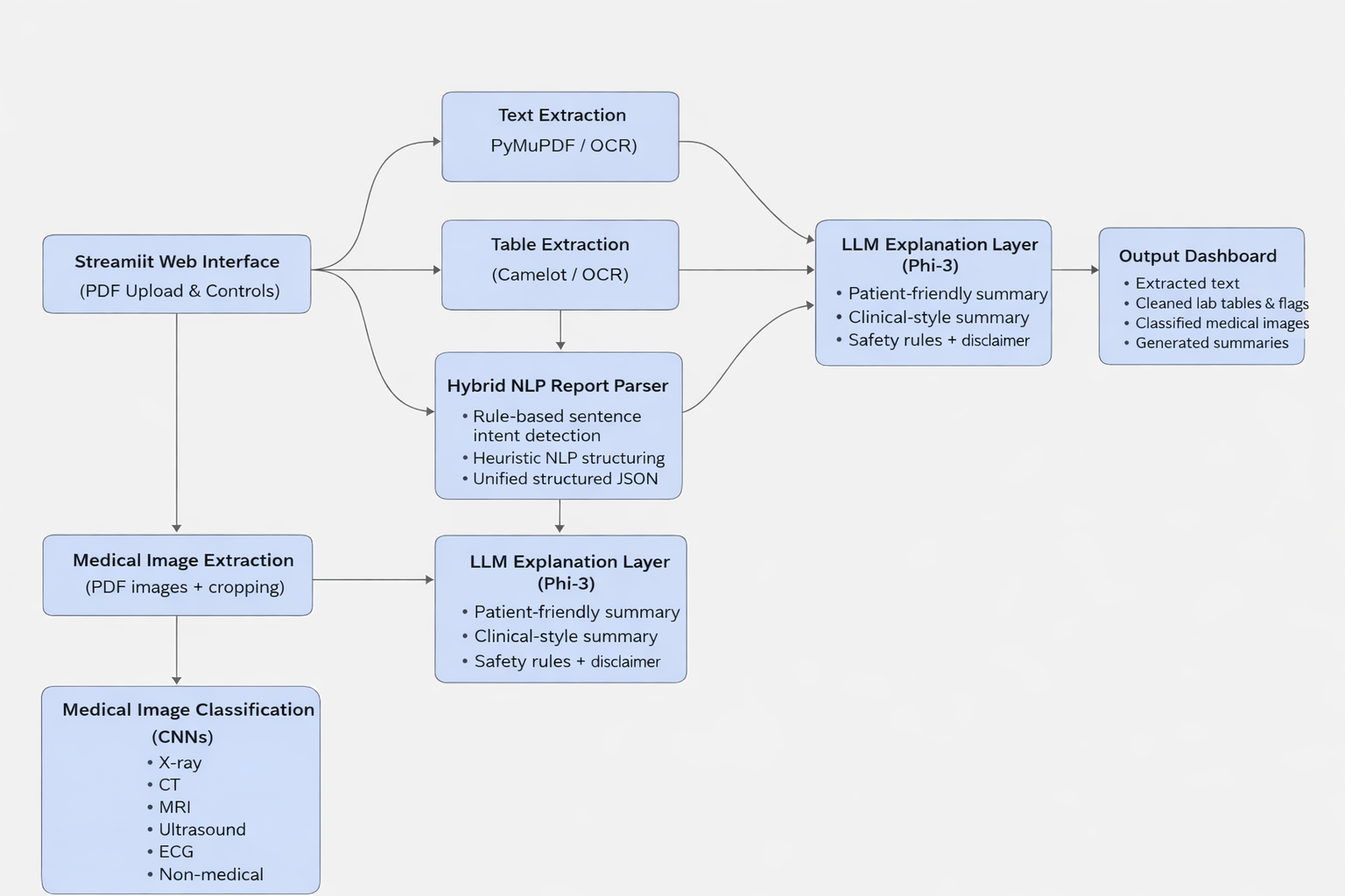
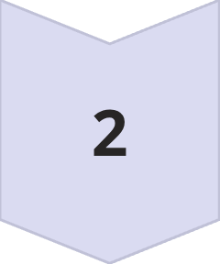
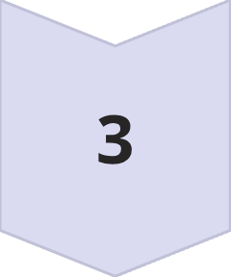
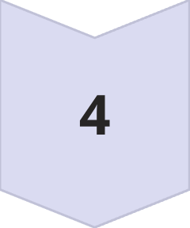
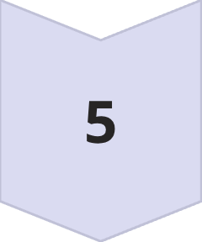
System Workflow Overview
The system processes documents through a sequential pipeline, with each module handling a specific extraction task.
Input Handler
PDF or image upload
Text Module
Extract & OCR
Table Module
Detect & parse
NLP Module
Structure text
Image Module
Classify modality

Slide 8
Implementation Strategy
Prototyping Phase
1
Initial exploration and testing in Jupyter notebooks allowed rapid experimentation with different libraries and approaches
Modularization
2
Converted notebook code into reusable Python modules with clear separation of concerns
Component Testing
3
Tested each module independently with sample medical documents before integration
Pipeline Integration
4
Combined modules into unified workflow with error handling and logging

Slide 9
Key Results & Learnings
What Worked Well
Challenges & Insights
OCR fallback successfully handled scanned documents
Poor quality scans degraded OCR accuracy significantly
Table extraction proved reliable for standard lab report formats
Non-standard table layouts required manual intervention
Rule-based NLP provided consistent section identification
Rule maintenance became complex with format variations
CNN classification distinguished between major image modalities
Limited training data constrained image classification scope
The iterative development approach allowed us to identify bottlenecks early and adapt our technical strategy accordingly.

Slide 10
